Slide 1
Where’s the Challenge?: Teaching through Play in PreK
Texas Region 4
Early Childhood Inclusion Conference
July 17, 2019

Slide 2
Introductions
Shannon Ayers, PhD
Senior Program Officer
The Nicholson Foundation
sayers@thenicholsonfoundation.org
Kaitlin Northey, PhD
Assistant Professor, Department of Education
University of Vermont
Kaitlin.Northey@uvm.edu

Slide 3
Agenda
Welcome and introductions
Developmentally Appropriate Practice (DAP)
The role of play in DAP
Why play?
Supporting play
Connecting play and learning
Plan for playful teaching

Slide 4
Developmentally Appropriate Practice (DAP)
NAEYC first position statement on DAP in the mid-1980s
Revisions in 1996, 2009, and currently under revision
Developmentally appropriate practice (DAP) is practice that promotes each and every child’s optimal learning and development. It is grounded in the research on child development and learning, in the knowledge base regarding educational effectiveness in early care and education, and in the knowledge that professional early childhood educators glean from their observations of and interactions with children and their families.

Slide 5
9 Principles of child development and learning and their implications for practice
Focus principle for today:
Play is an important vehicle for promoting the development of content knowledge as well as self-regulation, language, cognition, and social competence; it also serves as an important means of cultural expression.

Slide 6
Why play?
“In play the child always behaves beyond his average age, above his daily behavior; in play it is as though he were a head taller than himself” (Vygotsky, 1978, p. 102).
In play, children:
engage in situations that have rules (e.g., social expectations or game play)
perform roles
engage in verbal exchanges or communicate with materials
practice self-regulation skills
practice empathy as the game/situation unfolds and they respond in the moment
are intrinsically motivated

Slide 7
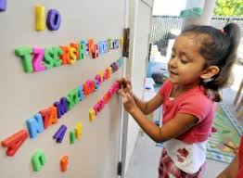
Connecting Development and Play
Language and Literacy
Narrative structure of sociodramatic play mirrors the narratives of story books
Children demonstrate their most advanced language skills during play

Slide 8
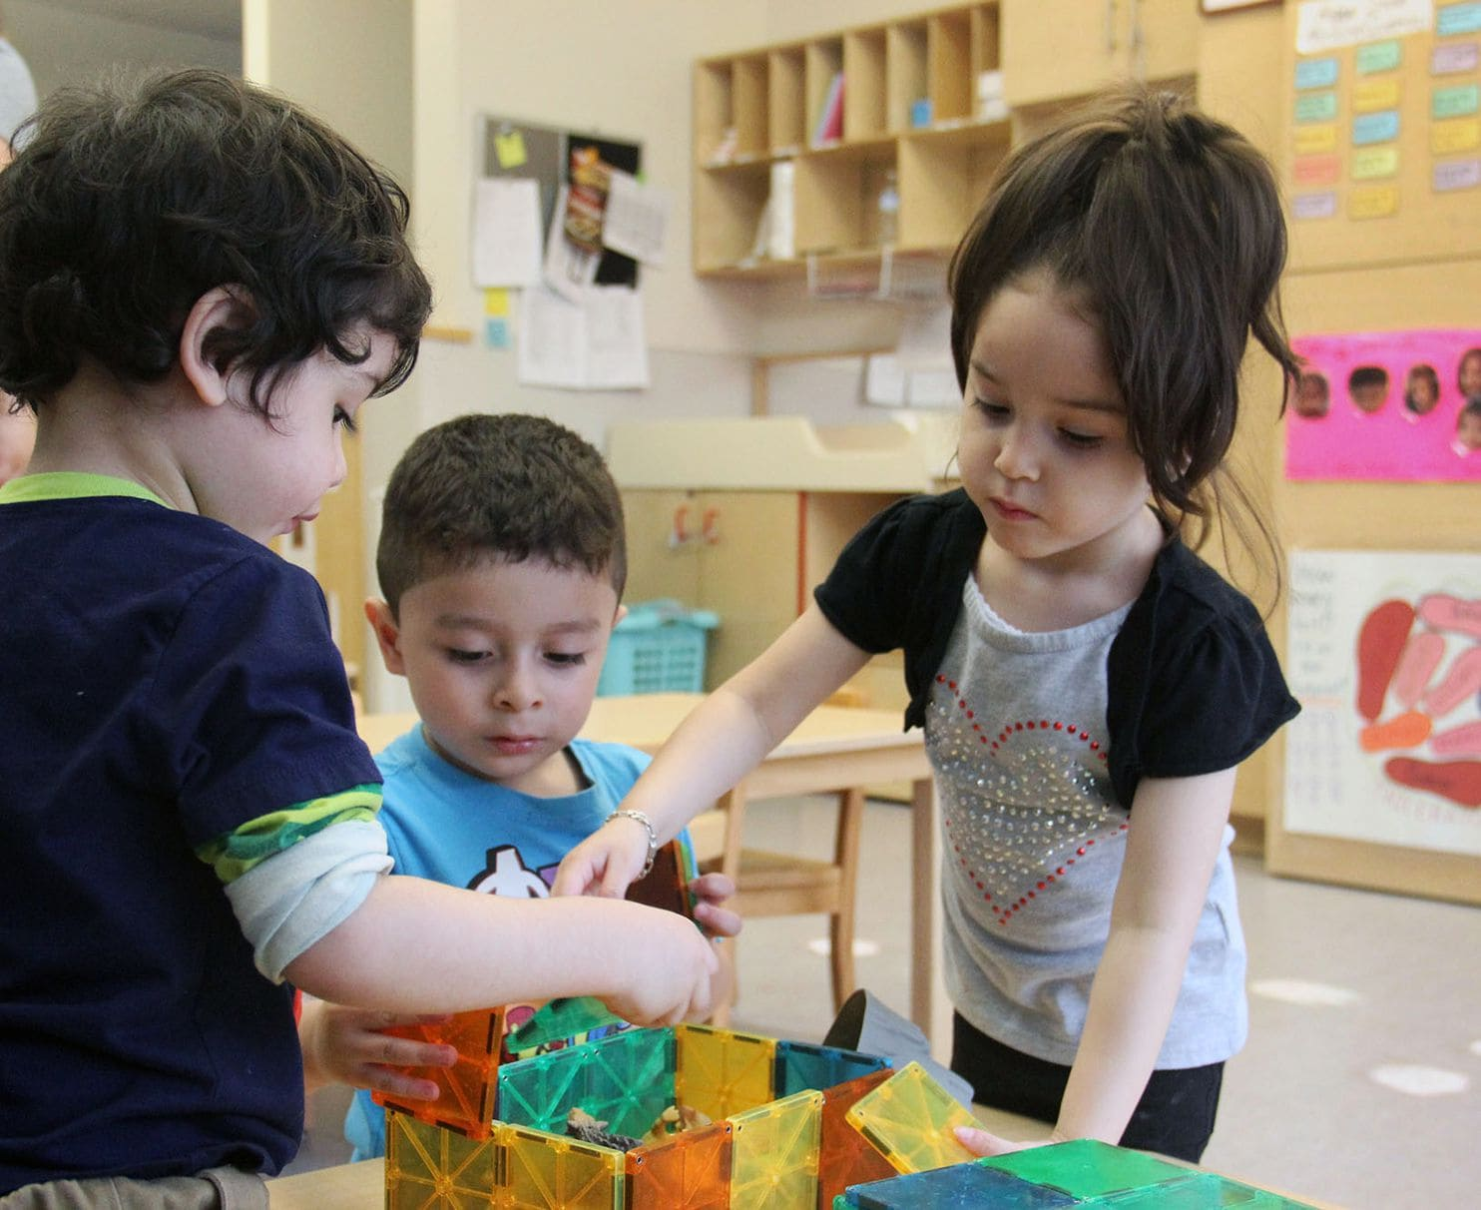
Connecting Development and Play
Math
Children’s free play contains mathematical learning 46% of the time (pattern and shape play, magnitude play, enumeration play)
Even directed, structured play of Chutes and Ladders produced an increase of numerical magnitude, number line estimation, counting and number identification

Slide 9
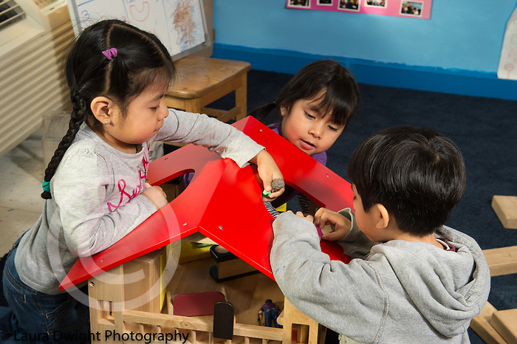
Connecting Development and Play
Social-Emotional
Negotiate with others, to take turns, and to manage themselves and others
Enhances emotional security by allowing children to work through anxieties

Slide 10
Table Activity – Free Discussion
One participant is the facilitator for your table’s discussion
Please discuss:
Why is play important for your children?

Slide 11
Large Group Discussion
Participants:
Describe what your facilitator did.
How did that help your process?
How could they have better supported your table’s work?
Facilitators:
What made it hard for you in this role?

Slide 12
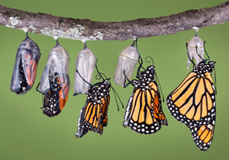
Understanding and Supporting Children’s Play

Slide 13
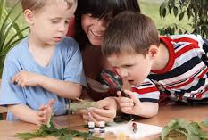
Teacher as observer
Teacher as doer
Jones, E. & Reynolds, G. (2011). The play’s the thing: Teachers’ roles in children’s play (2nd ed.). New York: Teachers College Press

Slide 14
Teachers’ Roles during Children’s Play
Stage Manager
Mediator
Player
Scribe
Assessor and Communicator
Planner
Jones, E. & Reynolds, G. (2011). The play’s the thing: Teachers’ roles in children’s play (2nd ed.). New York: Teachers College Press

Slide 15
Table Discussion
Review Handout: Engaging in Children’s Play
Share and discuss:
Revisit the play memory you shared earlier and identify the role of the teacher (you) in the interaction.
When or how will you challenge yourself to take on these different roles?

Slide 16
It’s time to stop the false dichotomy between “play” and “education”
A Mandate for Playful Learning in Preschool
Hirsh-Pasek, Golinkoff, Berk, & Singer

Slide 17
Connecting Play and Learning
Barriers to teaching through play and implementing DAP:
All children are at different levels
I’m not sure what my role is
I have to hit the standards

Slide 18
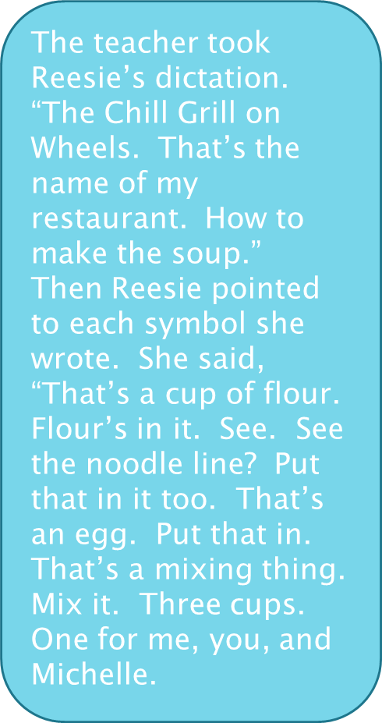
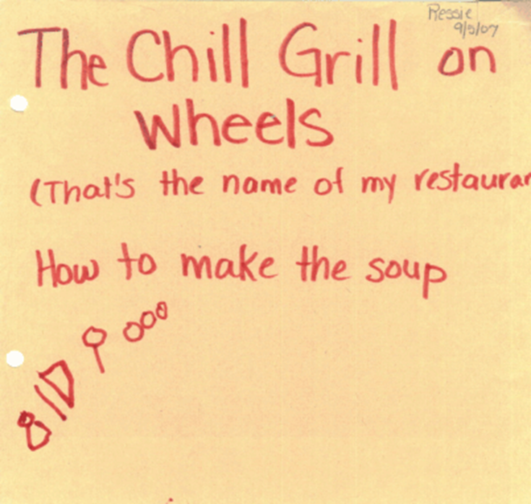
Learning in Spontaneous Play

Slide 19
Turn and Talk
Share a time when you saw learning happen in children’s play.
Describe your role in the play.
Now that you can reflect on that experience, describe what could have been a good next step if you were going to push that learning moment further?

Slide 20
Preparation for Teaching through Play
Seizing and creating teachable moments requires that teachers:
know the standards
know their learning goals
know their children
The goal is to create opportunities for learning that are challenging for each child and ALL children.

Slide 21
Preparation for Teaching through Play
Core considerations in developmentally appropriate practice
What is known about the processes of child development and learning in general, including how these processes occur within specific social, cultural, and historical contexts.
What is known about each child as an individual—specific information about each child, within the context of their family and community, which has implications for how best to be support their development and learning.
What is known about the social and cultural contexts affecting the delivery of early childhood education and care.
NAEYC DAP Position Statement Draft

Slide 22
Pathways for Teaching through Play
Teachers can plan:
engaging playful activities and environments
enter and extend children’s natural play
AND

Slide 23
Planning Engaging Playful Activities and Environments
Entering and Extending Children’s Natural Play
Anticipate interests
Build upon previous learning
Plan to use relevant vocabulary and higher order questions
Provide opportunities for whole group, small group, and 1:1
Provide appropriate and open-ended materials
Set children up for success
Design something enticing and provoking
Plant an idea
Leave them with a problem solve
Be aware of and seize upon their interests and wonderings
Ask questions to scaffold their learning
Insert vocabulary
Tie to previous learning
Connect to literature
Integrate this learning across domains

Slide 24
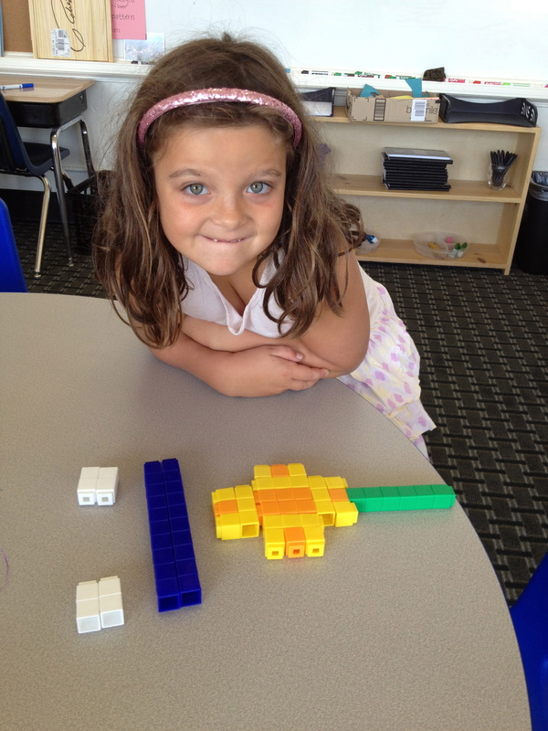
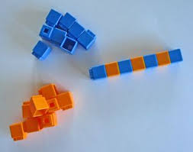
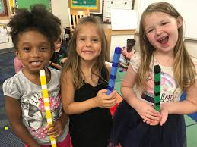
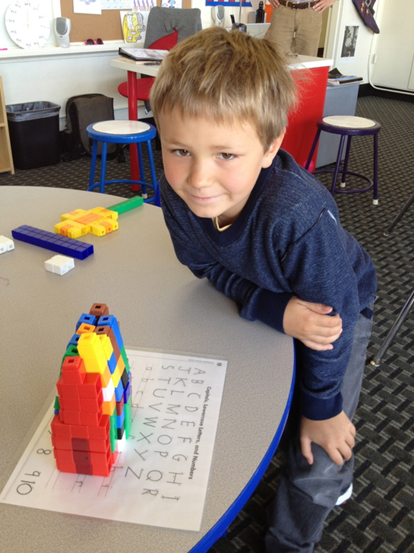
Planned Playful Learning
Unifix Cube Differentiated Lesson

Slide 25
Differentiating
In the materials provided
Questions you ask
Outcomes expected
Supports needed etc.
Size of group
Composition of group

Slide 26
Learning and Playing Plan (handout)
Think of something you currently teach that needs an update (or something you’re covering soon)
Where is the learning?
What is the standard?
What does it look like for your children (on-age, younger, etc.)?
Make a differentiated playful activity
How will you plant an idea and/or leave them a problem to solve?

Slide 27
Share plan with group
Rich discussion of strategies to overcome barriers

Slide 28
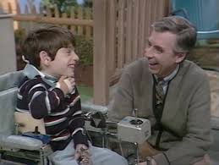
Thank You
Play is often talked about as if it were a relief from serious learning. But for children play is serious learning. Play is really the work of childhood.
Fred Rogers

